Slide 1
Machine Learning
Notes: Murad Popattia

Slide 2
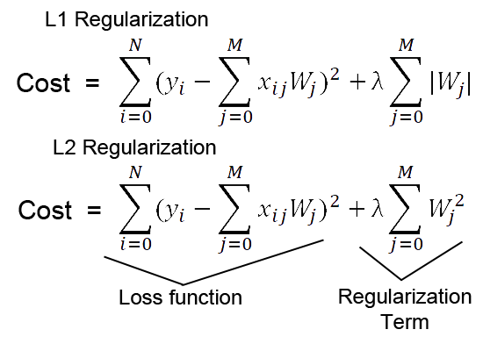
Ridge Lasso
A super important fact we need to notice about ridge regression is that it enforces the β coefficients to be lower, but it does not enforce them to be zero. That is, it will not get rid of irrelevant features but rather minimize their impact on the trained model.
Lasso method overcomes the disadvantage of Ridge regression by not only punishing high values of the coefficients β but actually setting them to zero if they are not relevant.
https://hackernoon.com/practical-machine-learning-ridge-regression-vs-lasso-a00326371ece

Slide 3
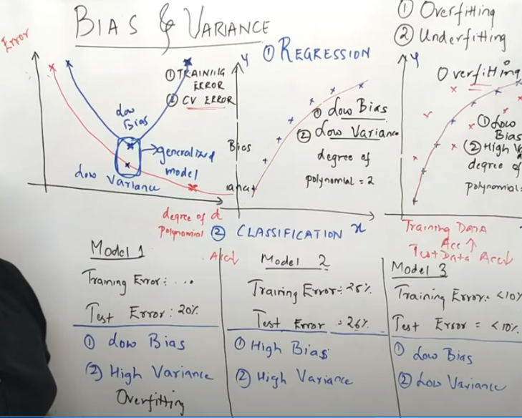
Bias and Variance
After certain point variance would be increasing, as we would be overfitting the problem statement.
Same is the case with decision trees. So we use decision pruning or random forest
Random forest is bootstrap aggregation, our complete data is not going so trees would be overfitting some part of the data and hence, the accumulated result would lead to low bias and low variance.

Slide 4
MultiCollinearity
Where independent features are correlated with each other
Hence, choosing a single features instead of both and ignoring the other would be ok.
We can use correlation matrix to find it

Slide 5
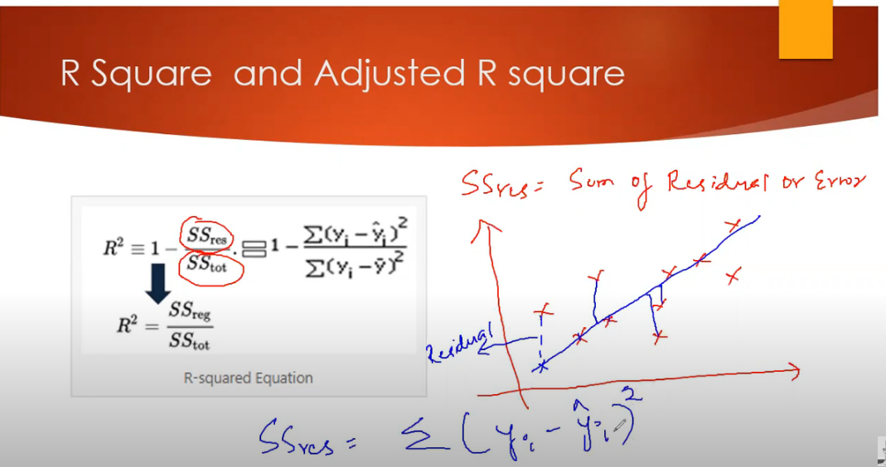
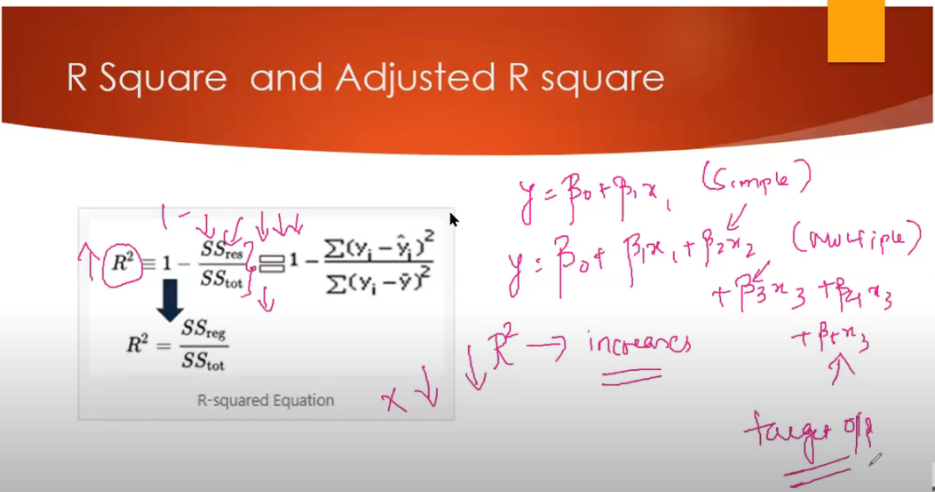
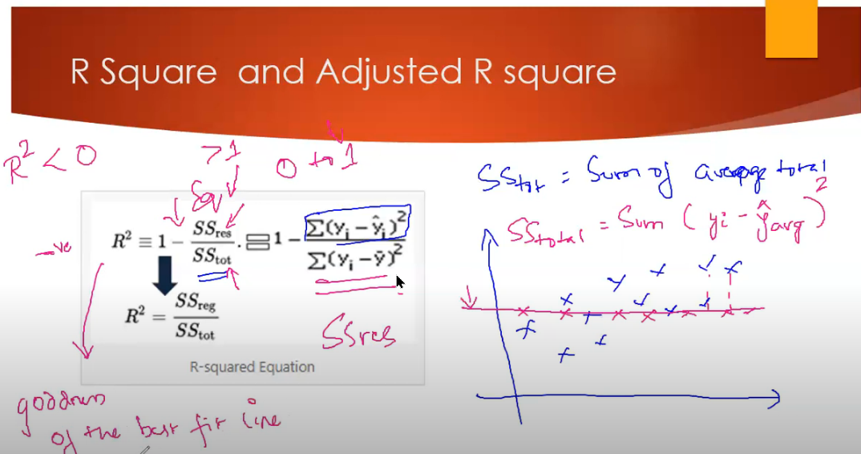

Slide 6
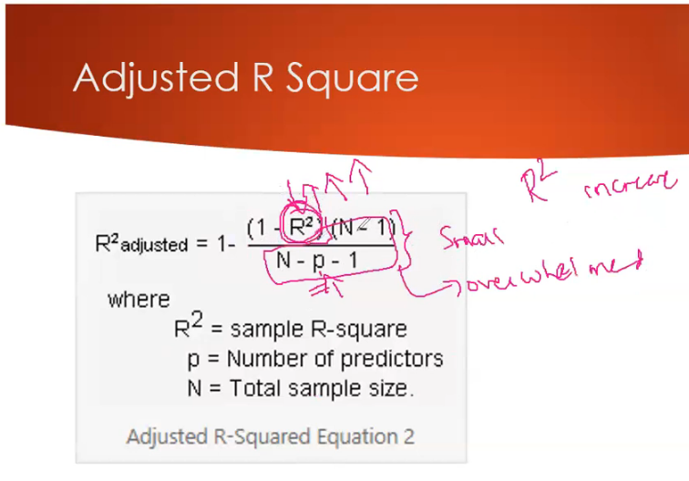
The R-square value increases as we keep on adding more features, but even when values that are not correlated with target variable.
Does not penalize the newly added features
So we use adjusted R-square

Slide 7
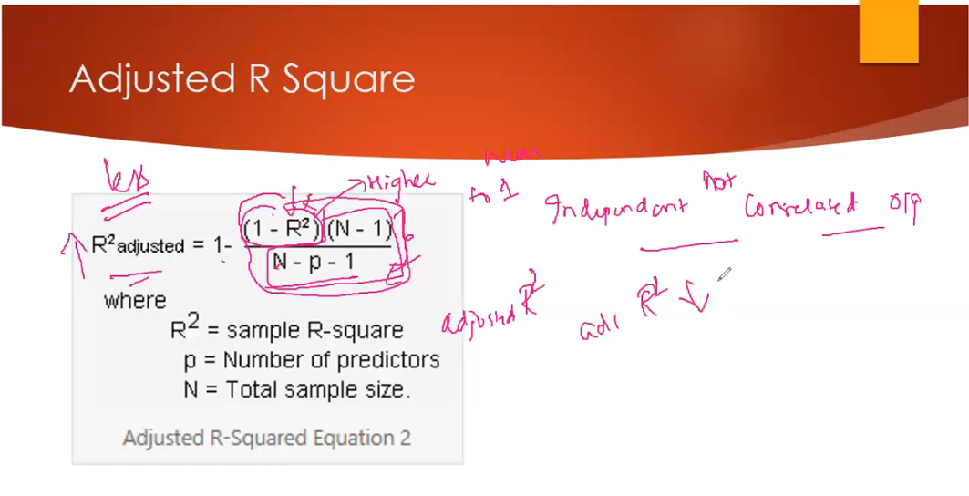
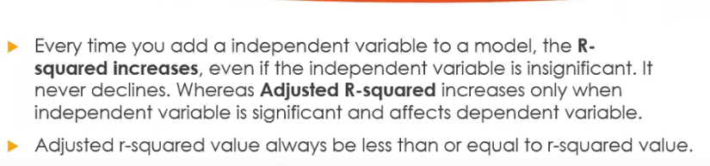
When features are correlated, R-square would be higher hence overall would be closer to 1 meaning higher.
However, if we are adding more features the division would penalize

Slide 8
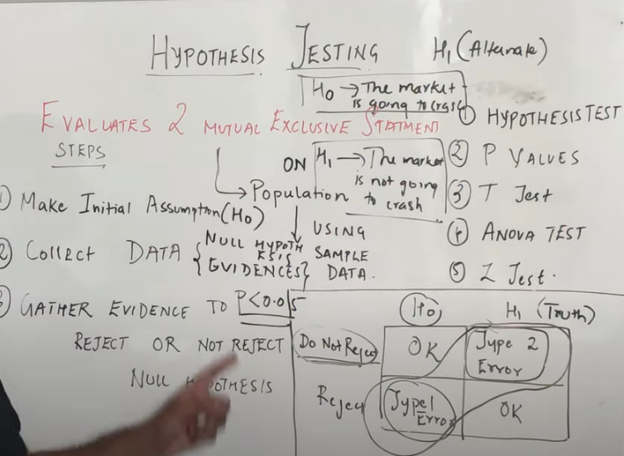
Hypothesis Testing
We evaluate Ho and H1 for a population using the sample data
P < 0.05 is the significance value. If P < 0.05 we reject the null hypothesis
Type 1 error when we don’t have enough evidence to support Ho and viceversa for Type 2

Slide 9
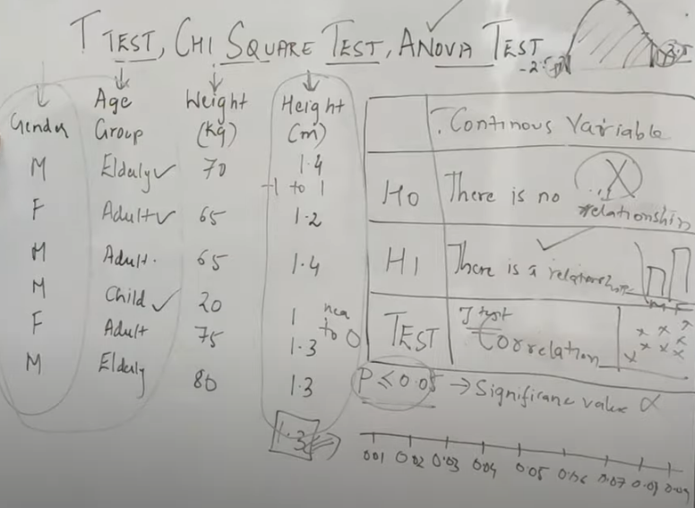
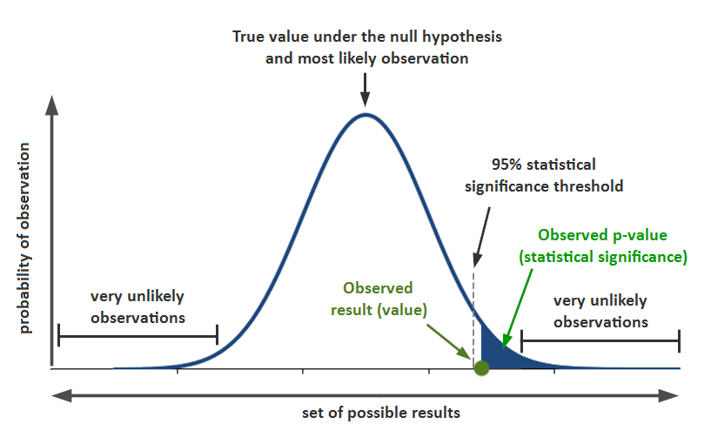
T test,Chi Square Test, Anova Test
1 categorical = One sample proportion test
2 categorical = chi-square test
1 continuous = t test
2 continuous = correlation
Multiple categorical 1 continuous = t test given that categorical has only 2 categories
Multiple categorical and 1 continuous = ANOVA test given that categorical has more than 2 categories
P <= 0.05 holds for all.

Slide 10
Some optional links
https://www.quora.com/How-can-I-use-students-T-test-for-feature-selection
https://towardsdatascience.com/chi-square-test-for-feature-selection-in-machine-learning-206b1f0b8223
https://www.analyticsvidhya.com/blog/2020/06/introduction-anova-statistics-data-science-covid-python/
In short these all help us to do feature selection, by seeing that which variables are statistically dependent or independent and hence between variables we check for independence and between target and variable we check for dependence to select features for our model.

Slide 11
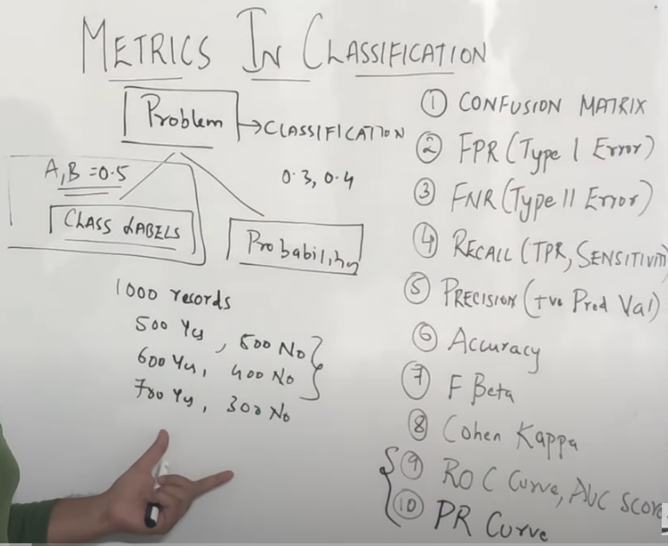
Performance Metrics For Classification
We can solve the classification using threshold values such as greater than 0.5 then has cancer or not , or we can use probabilities in case of multiple classes. Such as stage 1 cancer, stage 2 cancer etc.
If our data set is imbalanced then we cannot use accuracy

Slide 12
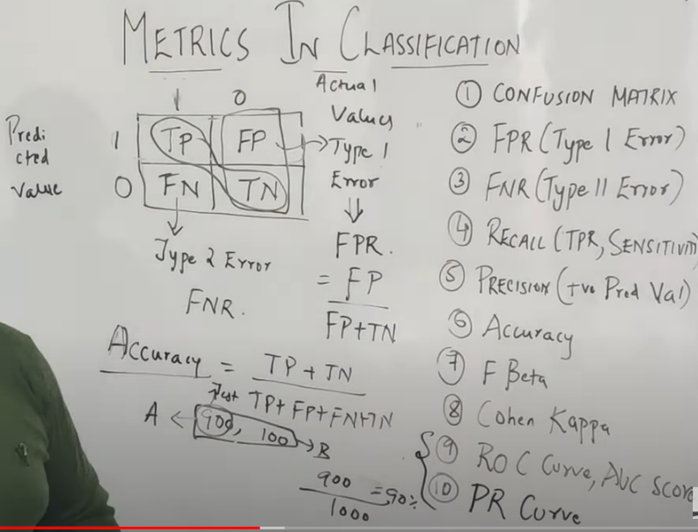
In balanced dataset, the model does not get biased hence we can use accuracy
Else see example of biased dataset 900 , 100 dataset.
We should always try to reduce Type 1 and Type 2 error

Slide 13
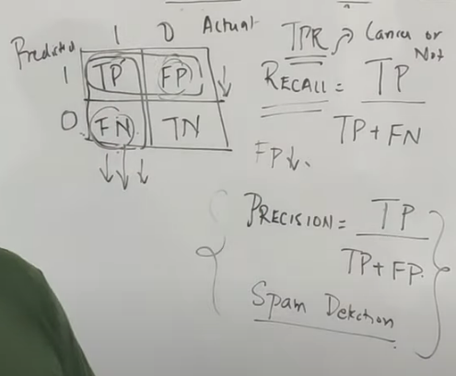
Precision vs Recall
If we can misclassify some points as positive then, we can allow for FPR. Such as people have cancer (1) and people don’t have cancer (0). So, recall in this case is important as we cannot have FNs!
If we can misclassify some as negatives then we can allow for FNR. Such as if some spams are classified as not spams, then not a issue. But we cannot have FPs. Meaning mail not spam is classified as spam! So precision is required.

Slide 14
PR vs ROC curve
In case of imbalanced dataset use PR
In case of balanced dataset use ROC
PR – Precision against recall
ROC – tpr against fpr
The key difference is that ROC curves will be the same no matter what the baseline probability is, but PR curves may be more useful in practice for needle-in-haystack type problems or problems where the "positive" class is more interesting than the negative class.

Slide 15
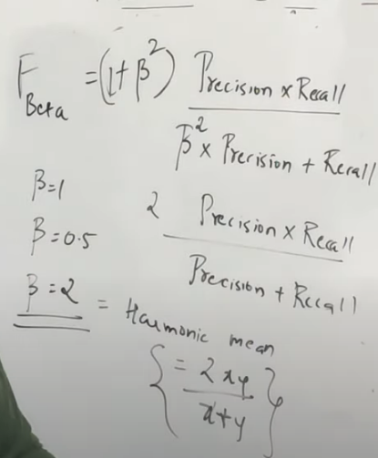
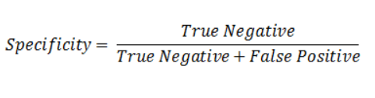
F-beta
If FPR is more important then we decrease the beta
If FNR is more important then we increase the beta
Specificity is
So, if we want to classify true negatives properly then we should use specificity

Slide 16
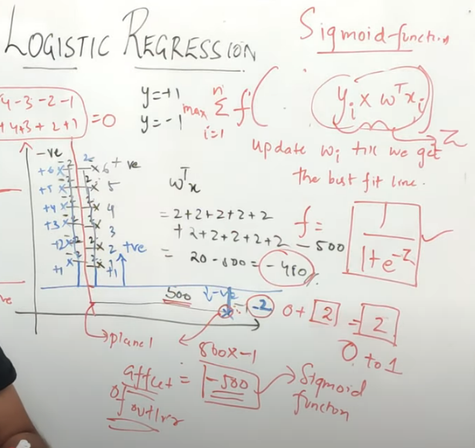
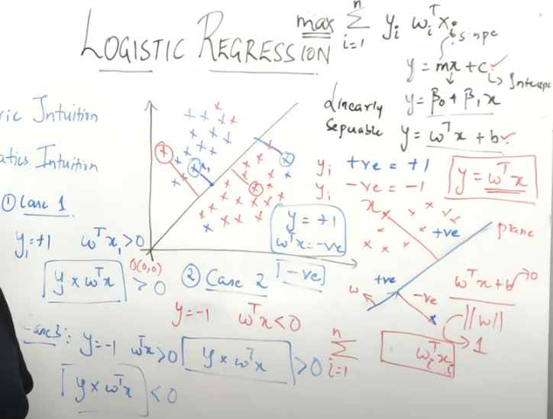
Logistic Regression
Cost function

Slide 17
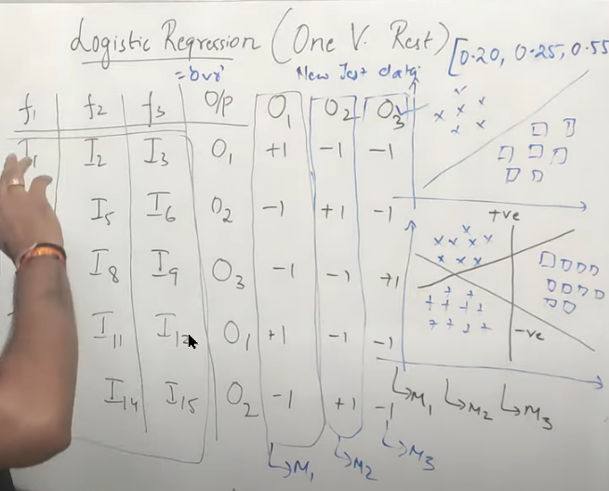
Linear regression cannot be used as it has a high error rate due to effect of outliers.
Hence, we use sigmoid function to remove this effect.
Moreover, we can use logistic regression of multiclass as well as it given probabilities as per number of output categories.
Higher probability means belongs to that category.

Slide 18
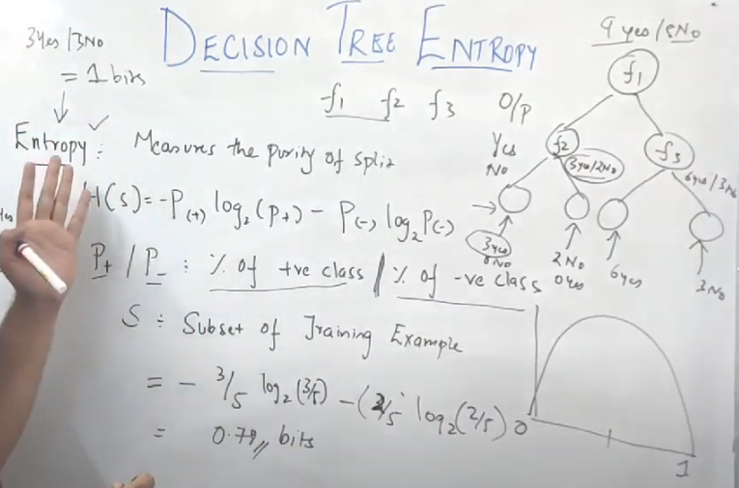
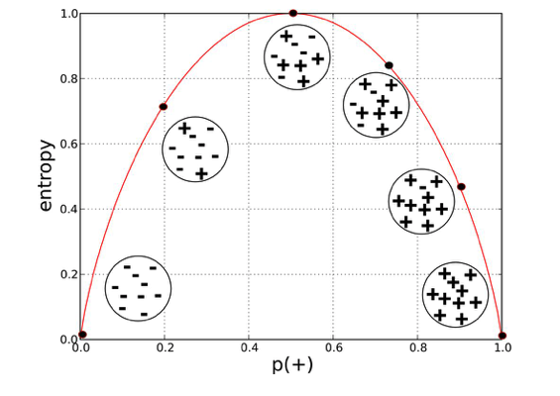
Decision Tree
Entropy is used to measure the purity of split. Ranges between 0 to 1
ID3 algorithms says that select right node for split. Stop at entropy 0 and entropy 1 means worst

Slide 19
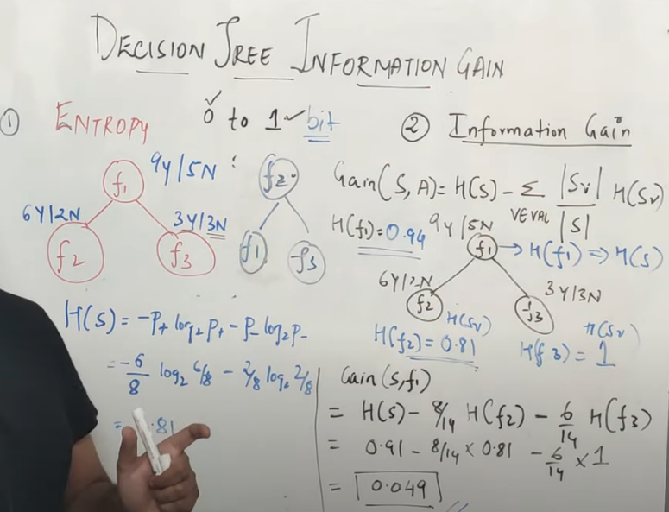
The split with the higher information gain will be used.

Slide 20
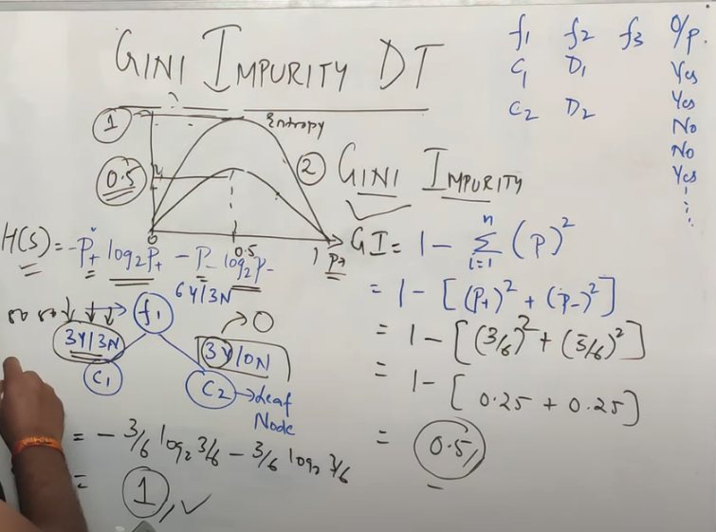
Gini Impurity
Gini impurity is more computationally efficient hence used instead of entropy.
Both do the same thing.

Slide 21
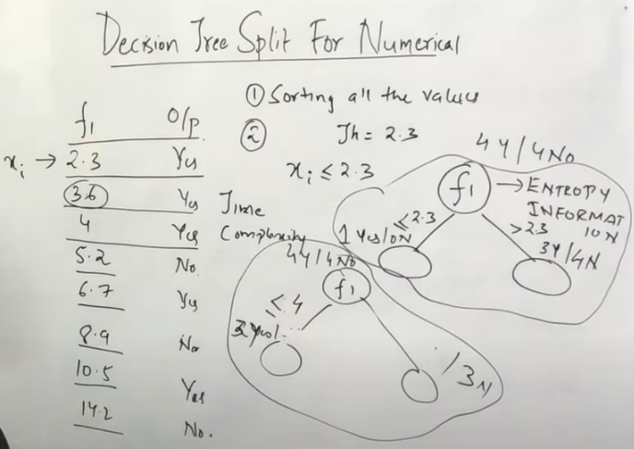
Decision Tree Split For Numerical Feature
It will turn by turn set each value as threshold and check information gain for each split.
Then it will take the one with the max information gain

Slide 22
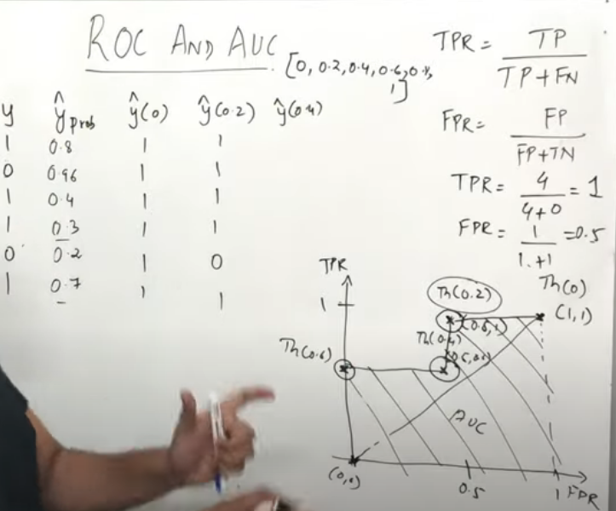
Performance Metrics(ROC,AUC Curve)
The area of the graph should be greater then this
In ROC curves we need to decide a specified threshold value to determine classes. Such that prob > 0.5 means class 1 etc.
So this 0.5 is the threshold and this lead to different results.
As in Krish’s video:
How To Find Optimal Threshold For Binary Classification

Slide 23
KNNs:
They are prone to imbalanced datasets
In KNNs regressor, the neighbors near the point to be predicted, are averaged out to give the value.

Slide 24
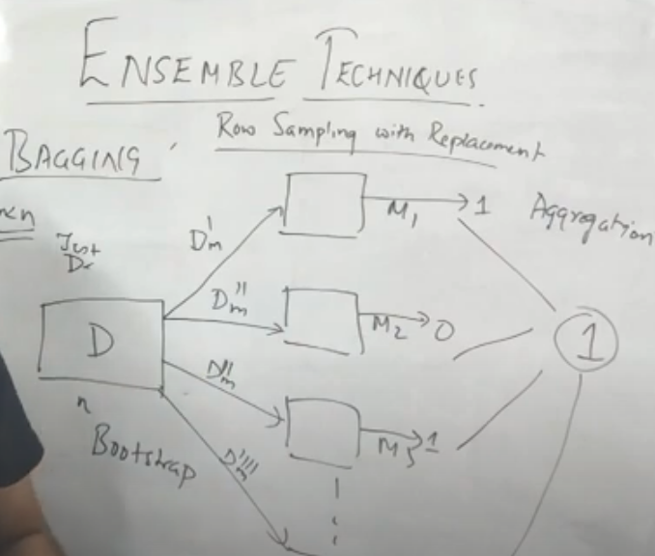
Ensemble: What is Bagging
A sample from the whole data is picked for each model with replacement

Slide 25
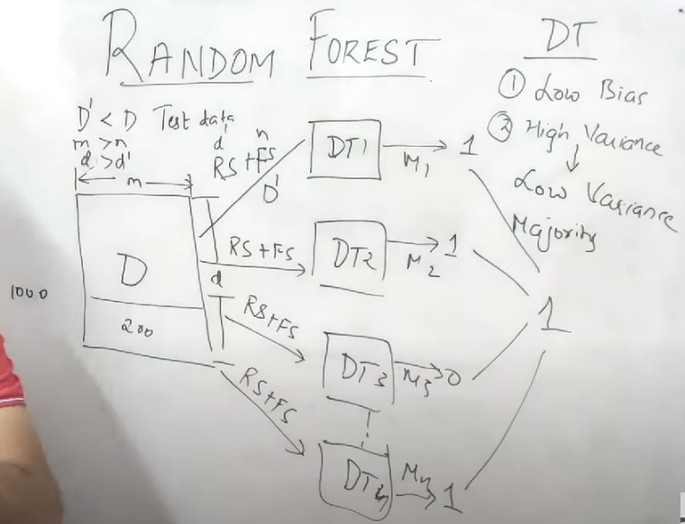
Random Forest Classifier
Row sampling : picking up some rows
Feature sampling : picking up some ‘n’ features
Classifier takes the majority vote while in case of regressor, it takes in the mean or median of the output of the trees.

Slide 26
Handling imbalanced Dataset
Machine learning algorithms can get biased
Under sampling: we take the same number of records from major class as compared to minor class.
Oversampling: we try to make the data in the minor class. Techniques involved include SMOTE etc.
If less records then do up sampling instead of under sampling
https://www.kdnuggets.com/2020/01/5-most-useful-techniques-handle-imbalanced-datasets.html

Slide 27
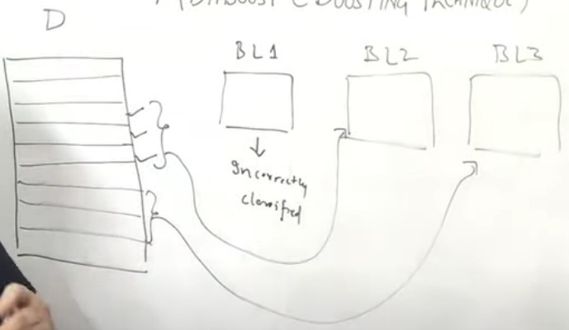
AdaBoost (BOOSTING TECHNIQUES)
Initially some samples are fed into the base learner. Consequently, records that are wrong are extracted and fed to the other base learners and so on..
These basically penalize the model by increasing the weights on the wrong predictions and continuing.

Slide 28
Here is a short description of all three methods:
Bagging (stands for Bootstrap Aggregation) is the way decrease the variance of your prediction by generating additional data for training from your original dataset using combinations with repetitions to produce multisets of the same cardinality/size as your original data. By increasing the size of your training set you can't improve the model predictive force, but just decrease the variance, narrowly tuning the prediction to expected outcome.
Boosting is a two-step approach, where one first uses subsets of the original data to produce a series of averagely performing models and then "boosts" their performance by combining them together using a particular cost function (=majority vote). Unlike bagging, in the classical boosting the subset creation is not random and depends upon the performance of the previous models: every new subsets contains the elements that were (likely to be) misclassified by previous models.
Other Classification parameters
Bagging:
parallel ensemble: each model is built independently
aim to decrease variance, not bias
suitable for high variance low bias models (complex models)
an example of a tree based method is random forest, which develop fully grown trees (note that RF modifies the grown procedure to reduce the correlation between trees)
Boosting:
sequential ensemble: try to add new models that do well where previous models lack
aim to decrease bias, not variance
suitable for low variance high bias models
an example of a tree based method is gradient boosting

Slide 29
Euclidean Distance and Manhattan Distance
These should be selected based on the case at hand and with the help of cross validation as it is a sort of hyper parameter.
Manhatten
Euclidean

Slide 30
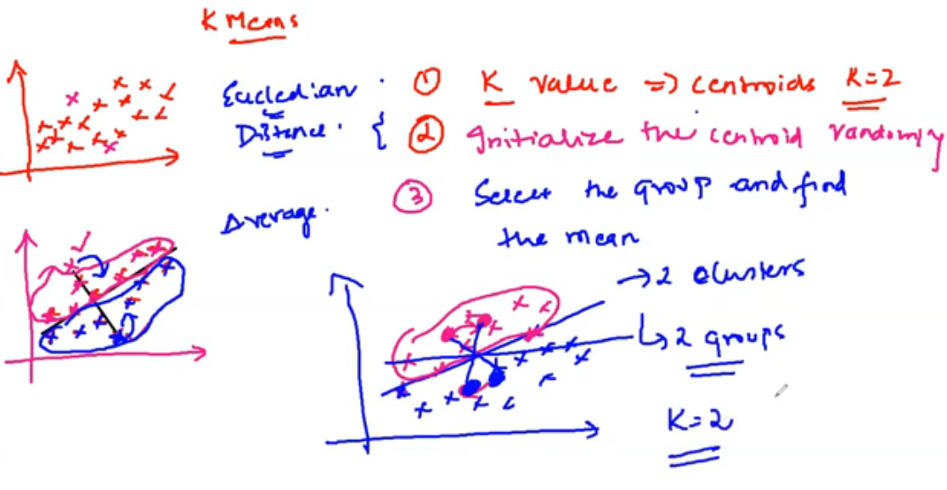
K Means Clustering

Slide 31
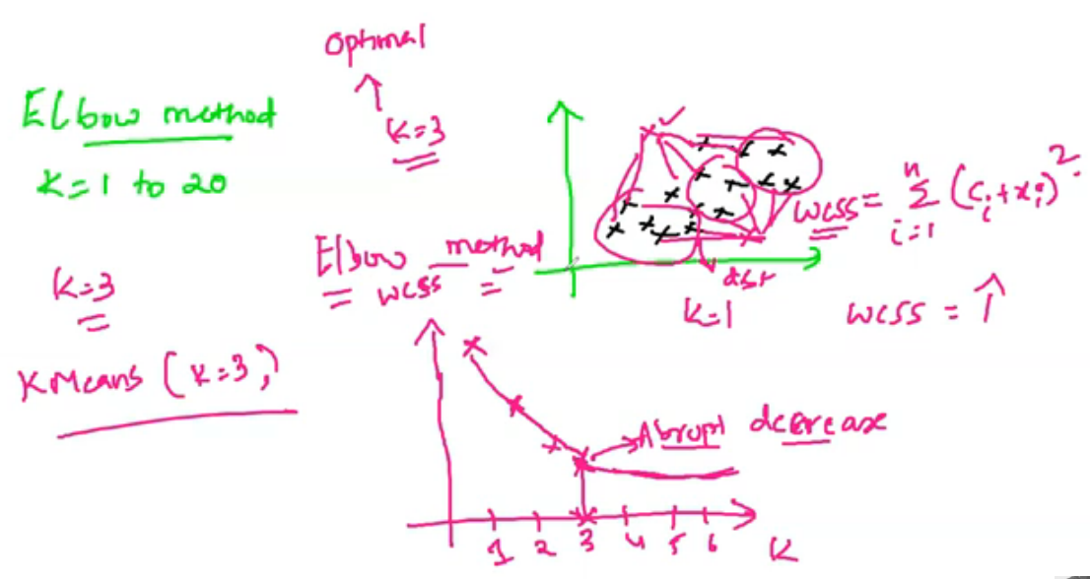
How we choose the value of k?
K means ++ is same as K means with the difference in selection of centroid.
Instead of random selection, the k value gets selected based on probability of its distance from the other centroid.

Slide 32
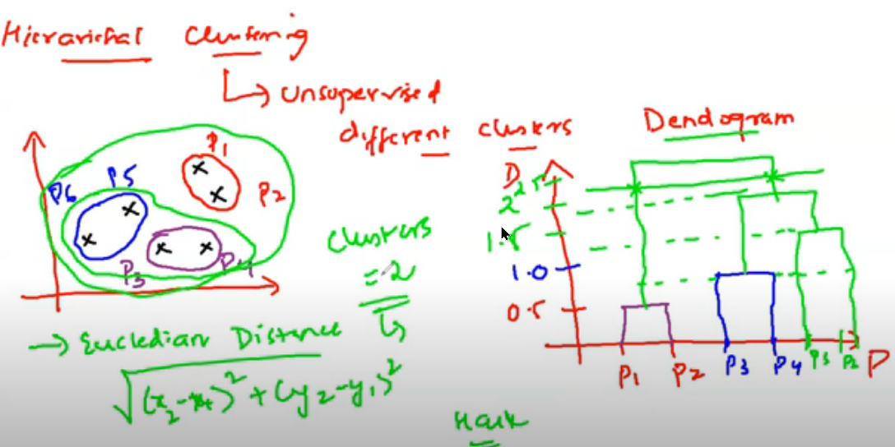
Hierarchical Clustering
The hack is to find the vertical line by which no horizontal line coincides. We then pass a line through it to see how many points it crosses and that many clusters we then have
Dendrogram is used to represent a hierarchy of clusters.

Slide 33
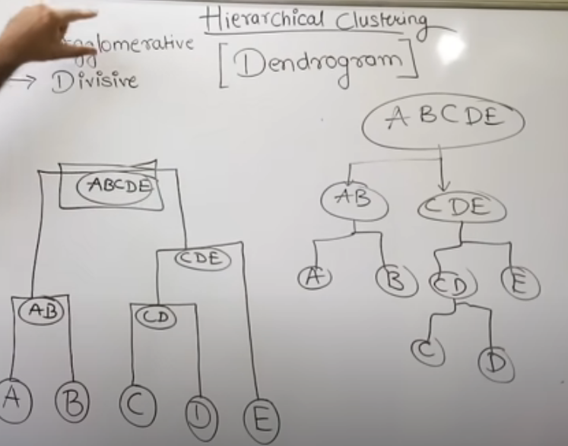

Slide 34
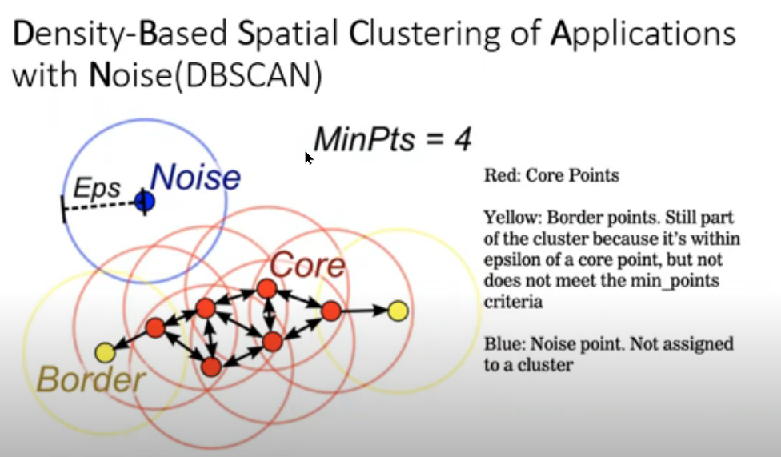
DBSCAN Clustering
We consider a boundary based on Epsilon
Core point: that has some min no. of points within the boundary
Boundary point: that has at least 1 core point within the boundary
If we have no core point then it is a noise point.

Slide 35
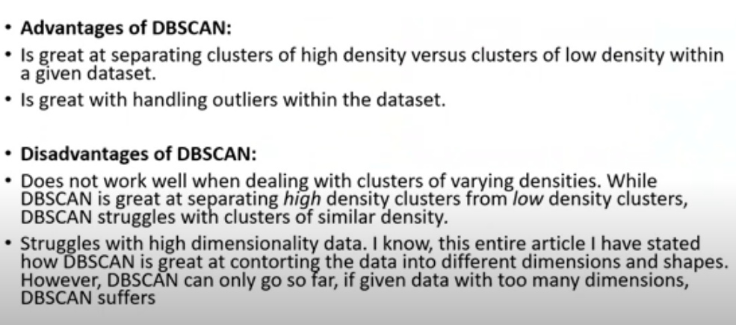
We do not have to specify clusters in DBScan hence advantage!
Silhouette scores are used to validate the validity of the value of k for clusters, by seeing that distance of points within the cluster from centroid is << distance of points outside that cluster from centroid

Slide 36
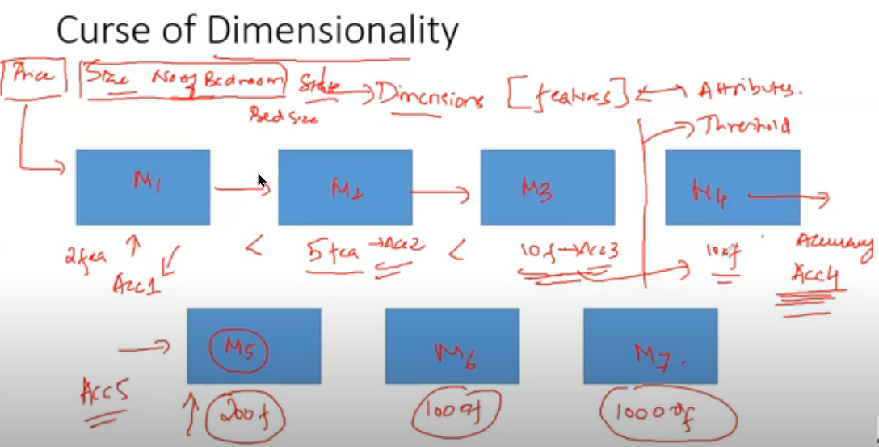
Curse of Dimensionality
Accuracy increases but upto a certain amount of features, after which the greater no. of features confuse the model.

Slide 37
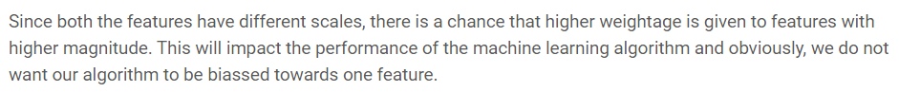
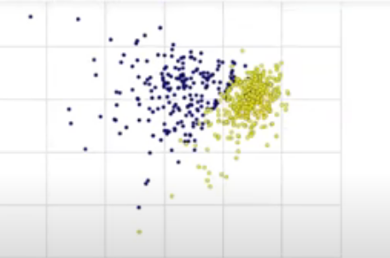
Dimensional Reduction
Algorithm to reduce number of dimensions.
Feature scaling is necessary because:
Reducing the number of dimensions is a part of the data preprocessing and hence can help us in getting better results from our model. As the breast cancer dataset shown when reduced to 2d can use logistic regression or Knn to classify.
For deep learning, we use auto-encoders and decoders inplace of PCA.

Slide 38
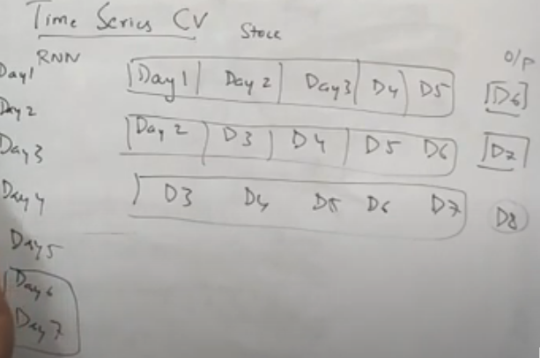
Cross Validation
LOOCV: can lead to low bias and high variance
Kfold CV
Stratified CV: data in the split has good proportion of classes
Time Series CV: data is dependent on each other so sequence matters as shown:

Slide 39
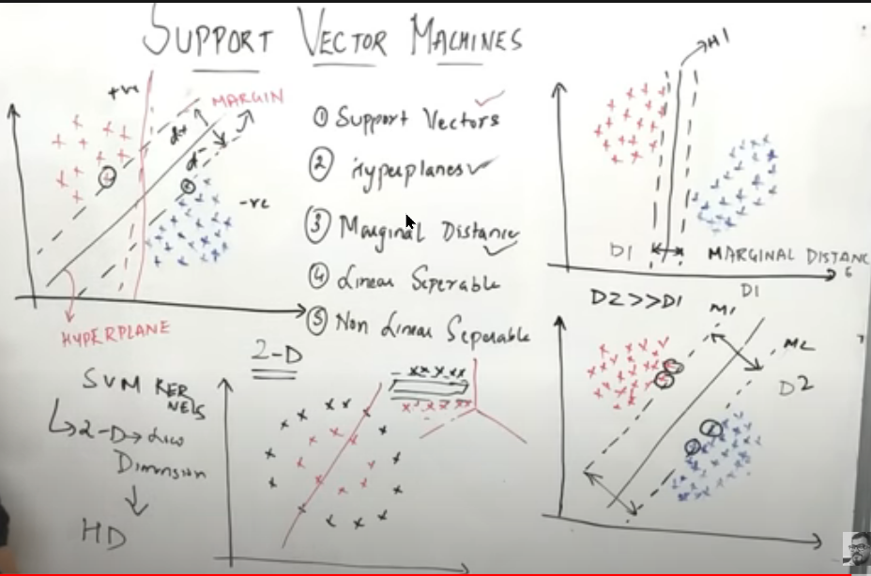
Support Vector Machine
Can be used to solve both regression and classification
We select the hyperplane with maximum marginal distance

Slide 40
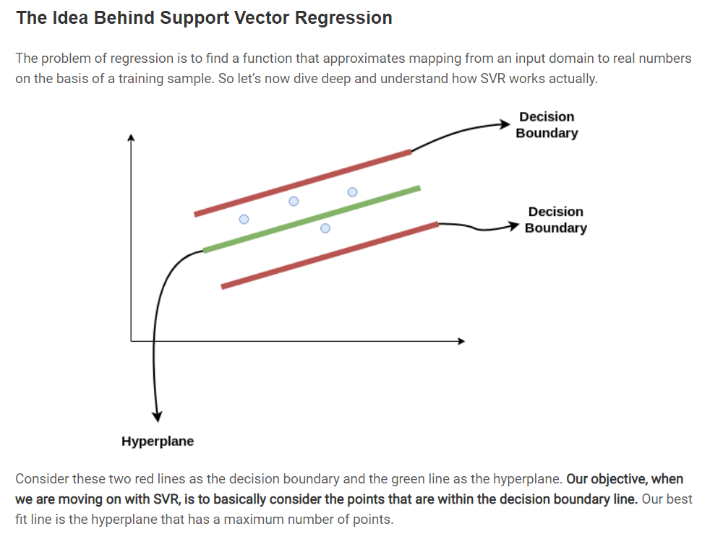

Slide 41
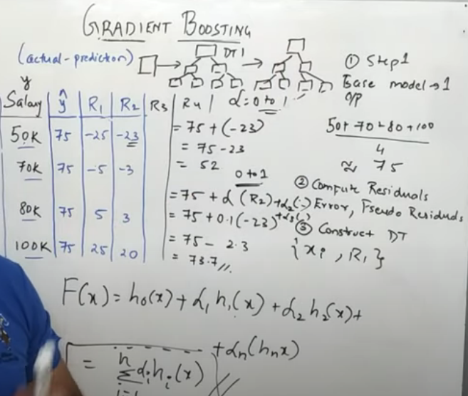
Gradient Boosting
Gradient boosting works by feeding in the residual errors with a learning rate and over time the learners aim to reduce this residual error
Base model is made from the average of the target classes

Slide 42
Natural Language Processing
Notes: Murad Popattia

Slide 43
Stemming and Lemmatization
Lemmatization converts words to a stem that is meaningful.
Stemming only converts to the base word but not necessary about meaning. E.g. sentiment analysis, gmail spam classifier
Lemmatization takes more time as it converts to a meaningful word.

Slide 44
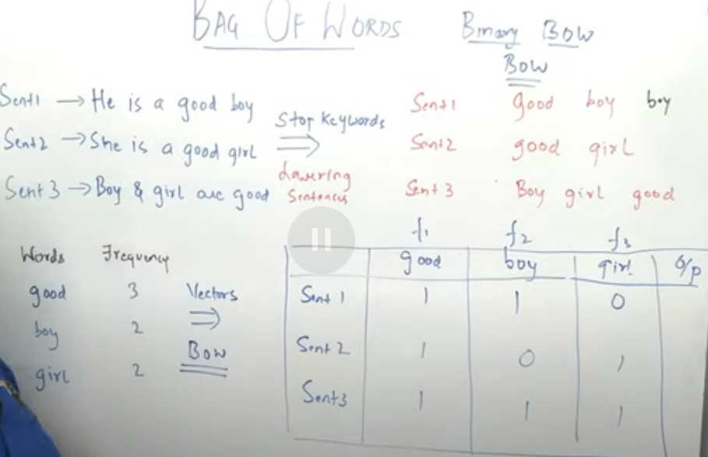
Bag Of Words
We need to convert our sentences to numbers (vectors)
We can:
Lower sentences (not in case of IN or USA etc.)
Remove stop words
Stem or lemmatize
Types:
Binary BOW:
We denote the presence of the words as 1, 0
BOW
We denote the presence of words as frequencies.
Problem:
Cannot derive semantic meaning out of the vectors such as boy and good both are assigned same weight. However, in sentiment analysis ‘good’ should be given more weight when assessed by model

Slide 45
TF-IDF

Slide 46
Interview Prep

Slide 47
Feature Scaling
Required in algorithms that makes use of distances such as Euclidean etc.
For example, tree based models such as decision tree, bagging, random forest, and boosting are robust to multicollinearity issues in their aspect of prediction accuracy.
Multi collinearity

Slide 48
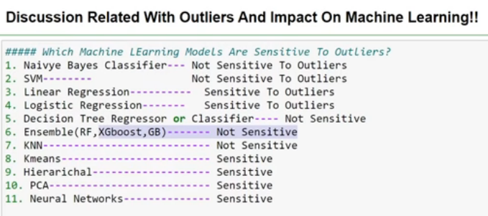
Outliers and imbalanced dataset problem:
Svm, logistic regression, random forest classifier, decision tree classifier, knn, naive Bayes are affected by imbalanced data set
https://www.quora.com/Are-some-ML-algorithms-more-vulnerable-to-unbalanced-training-sets-than-others-Why

Slide 49
High dimensionality Problem
dataset is small compared to the number of features
Curse of dimensionality
https://stats.stackexchange.com/questions/186184/does-dimensionality-curse-effect-some-models-more-than-others
Linear and Logistic Regression (affected)
Decision Trees/RandomForest/Boosted Trees (affected)
Neural Networks (not affected)
SVM (not affected)
Naïve bayes (not affected)
kNN (greatly affected)
k-means clustering (greatly affected)

Slide 50
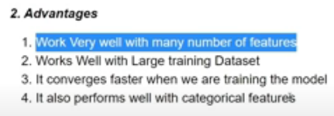
Naïve Bayes Classifier
Works with independent features
Hence, correlated features will affect
performance so affected by multicollinearity
Works on probability hence no feature scaling
Handles missing values as during calculation of probability, the missing values are ignored
Laplace smoothing helps to deal with zero probability
Applications: sentiment analysis, spam classification, document categorization
Because of the class independence assumption, naïve Bayes classifiers can quickly learn to use high dimensional features with limited training data compared to more sophisticated methods

Slide 51
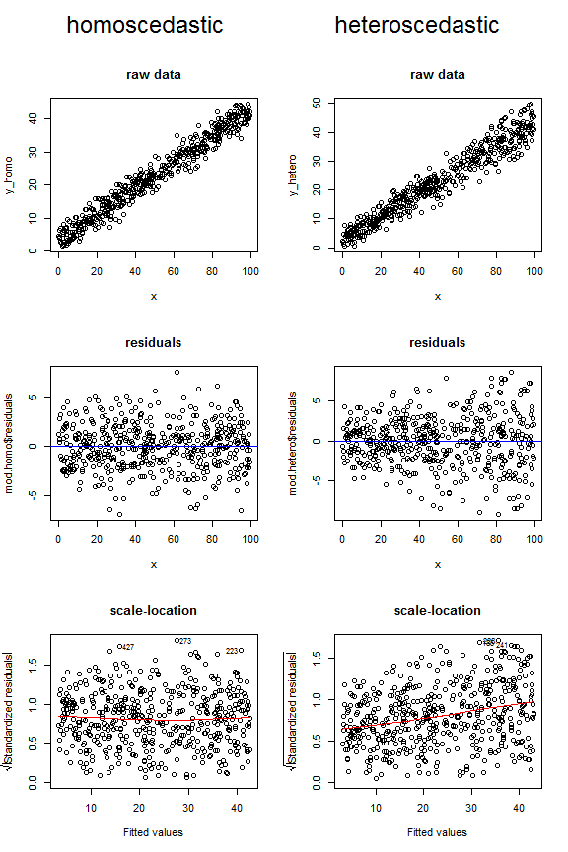
Linear Regression
Assumptions:
Features should have gaussian distribution
Features should be independent
Residual plot should be well spread not following a pattern
Linear relation between X and Y mean
Adv:
Easy to implement
Good linearly separable data
Disadv:
Lot of feature engineering
Prone to noise and overfitting
Multicollinearity affects
Feature scaling required. Helps in reaching minima faster and avoid biasness in some cases
Sensitive to missing values and outliers

Slide 52
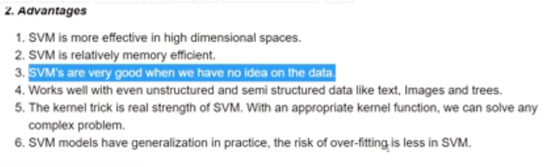
Support Vector Machines
We can solve linear and non linear problems as it used kernels
Handles overfitting as per the regularization parameter C
Disadv:
Slow on larger dataset
Need finetuning for parameter and kernel function
We create margins hence need feature scaling
Sensitive to outliers and missing data as it creates margin
We can create soft margins that allow some misclassified points to enter to avoid overfitting
Does not use all features, when creating the hyperplane hence, can be used for high dimensional data unlike random forest that considers all features

Slide 53
Decision Trees
Adv:
Easy to interpret
Can be used for both continuous and categorical
No feature scaling
Can handle missing data as it splits up into features hence, the variables can be guessed
Robust to outliers as outliers will only be in a specific branch which can be pruned and never involved in split
Less training period
Disadv:
Overfitting hence not suitable for large datasets
Unstable as the tree would be created everytime a new feature added

Slide 54
Logistic Regression
Assumptions:
independent variables are linearly related to the log odds
Adv:
Easy to understand. Less training
Accurate for linear separable data
Less prone to overfitting due to regularization
Disadv:
Feature scaling needed
Prone to Multicollinearity can lead to overfitting
Sensitive to missing value and outlier so we can use sigmoid function to put the value between 0 – 1, hence removing the affect of outlier.

Slide 55
Random Forest Algo
Low bias and low variance : removes overfitting to decision tree
Adv:
No overfitting
Less feature scaling or parameter tuning
Handles both categorical and continuous
Disadv:
Affected by high dimensionality, leads to biasness where there are many features

Slide 56
Some concepts:
MSE vs R2
https://vitalflux.com/mean-square-error-r-squared-which-one-to-use/#:~:text=Sum%20of%20Squares%20Regression%20is,better%20is%20the%20regression%20model.&text=If%20the%20value%20of%20R,with%20a%20corresponding%20MSE%20%3D%200.
MSE RMSE vs MAE:
https://www.kaggle.com/c/home-data-for-ml-course/discussion/143364

Slide 57
Difference between AdaBoost and XGBoost.
Both methods combine weak learners into one strong learner. For example, one decision tree is a weak learner, and an emsemble of them would be a random forest model, which is a strong learner.
Both methods in the learning process will increase the ensemble of weak-trainers, adding new weak learners to the ensemble at each training iteration, i.e. in the case of the forest, the forest will grow with new trees. The only difference between AdaBoost and XGBoost is how the ensemble is replenished.
AdaBoost works by weighting the observations, putting more weight on difficult to classify instances and less on those already handled well. New weak learners are added sequentially that focus their training on the more difficult patterns. AdaBoost at each iteration changes the sample weights in the sample. It raises the weight of the samples in which more mistakes were made. In addition, in AdaBoost, each weak learner has its own weight in the ensemble (alpha weight) - this weight is higher, the “smarter” this weak learner is, i.e. than the learner least likely to make mistakes.
XGBoost does not change the selection or the distribution of observations at all. XGBoost builds the first tree (weak learner), which will fit the observations with some prediction error. A second tree (weak learner) is then added to correct the errors made by the existing model. Errors are minimized using a gradient descent algorithm. Regularization can also be used to penalize more complex models through both Lasso and Ridge regularization.
In short, AdaBoost- reweighting examples. Gradient boosting - predicting the loss function of trees. Xgboost - the regularization term was added to the loss function (depth + values ​​in leaves).

Slide 58
Pearson correlation vs Spearman correlation
Pearson assumes for linear relation and normally distributed and continuous (linearity and homoscedasticity)
Spearman assumes that the relation should be monotic and ordinal meaning that numeric value denotes the weight of it.

Slide 59
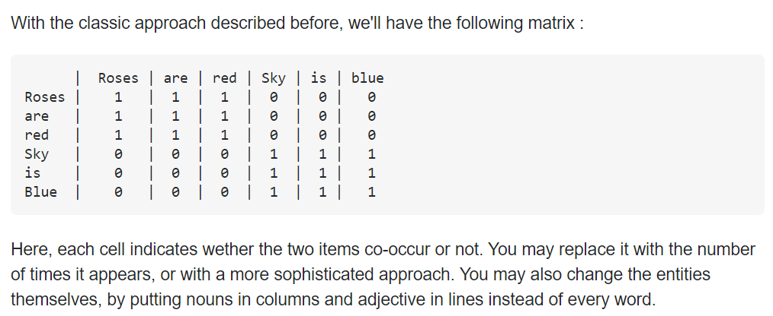
Glove vs Word2Vev
Word2Vec tends to capture word context by converting them to vectors using skipgram and cbow then tries to predict next word based on a window size.
Glove capture global context of the words instead of a local context like in word2vec. By focusing on a cooccurrence matrix.
While word2vec is based on
vectors of the words.

Slide 60
Confidence Interval
Confidence Interval is a range of values we are fairly sure our true value lies in.

